Slide 1

BRITISH AIRWAYS
CUSTOMER EXPERIENCE ANALYSIS

Slide 2
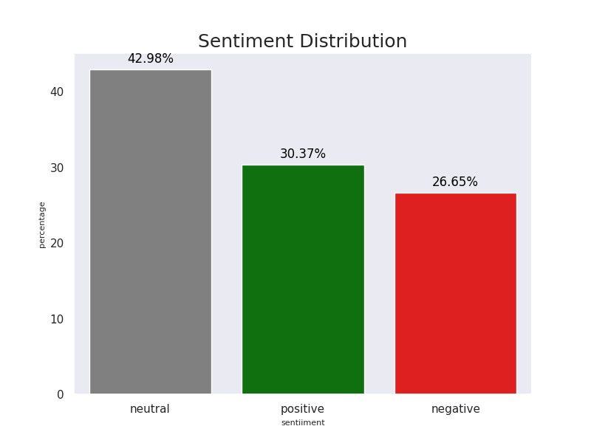
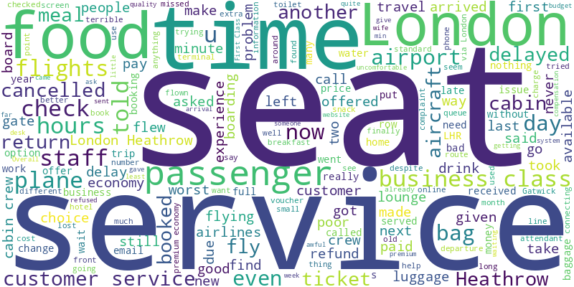
CUSTOMER REVIEWS SENTIMENT ANALYSIS
TOTAL NUMBER OF REVIEWS
3688
AVERAGE SENTIMENT PER REVIEW
0.415
Indicates a slightly positive general sentiment
30.37% of reviews are positive
With 42.98% being neutral
COMMON WORDS IN NEGATIVE REVIEWS
Service is mentioned a lot in negative reviews
Alongside seats and time.
In general most of our reviews lean towards the positive side

